Slide 1
DV and Homelessness

Slide 2
Acknowledgments
Kendra Gritsch
Kris Billhardt
Jill Davies
Leigh Hofheimer
Ilene Stohl
Maria Williams
Rachael Moulton
And the many housing/homeless providers who offered insight and feedback!
Thank you!
Linda Olsen

Slide 3
Domestic Violence for Housing/Homeless Providers
The Relationship IS the Intervention!

Slide 4
OUTLINE
DV and Homelessness
Recognizing and Responding to Domestic Violence
Safety Planning: Safety versus SafeR
Legal Protections for DV Survivors
What About Immigrants
Working with DV Advocates and Agencies

Slide 5
How does DV lead to homelessness?
DV is a leading cause of homelessness for women and children (families) in the U.S.
Survivors often must leave housing to escape DV
Survivors may be unable to afford to stay if abuser leaves
May be evicted due to abuser’s behavior
DV interferes with ability to access housing - bad credit, poor rental histories, safety needs
Abusers may sabotage survivor’s economic stability - trouble paying deposit, rent and utilities

Slide 6
IMPACTS OF TRAUMA ON HOUSING STABILITY
DV/SA can severely disrupt survivors’ lives & are significant contributing factors to chronic homelessness in women
Survivors who can’t retain their housing are highly vulnerable to re-abuse
Homeless survivors may seek the perceived safety of a new partner and become the victim of survival sex and other coercive control
Survivors may engage in illegal activity in order to survive, leading to criminal history records
Survivors frequently become disconnected from their social support network

Slide 7
People of color more likely to experience homelessness
Center for Social Innovation’s SPARC (Supporting Partnerships for Anti-Rascist Communities) project examined over 111,000 HMIS records, collected 148 oral histories of people of color experiencing homelessness, conducted 18 focus groups in six U.S. communities, and found:
More than 78% of people experiencing homelessness were people of color. The general population in the U.S. is 74% White, 12.4% Black, and 17.2% Hispanic/Latinx.
Black people comprise 13% of the general population in the U.S. and 26% of those living in poverty, yet account for more than 40% of the homeless population. Poverty rates alone don’t explain the over-representation.
Homelessness among American Indian/Alaska Native people was three to eight times higher than their representation in the general population.

Slide 8
ROOT CAUSES OF HOMELESSNESS ARE STRUCTURAL
Lack of affordable housing, economic immobility, and systemic racism
People did not become homeless because of lack of financial resources, but rather as a result of fragile social networks marked by two weak points: lack of financial capital and lack of emotional support.
SPARC calls this phenomenon “network impoverishment” —a phenomenon in which it is not just the individual or family who is experiencing poverty; the network itself functions in an impoverished state
DV/IPV was also identified as a common thread in the lives of many respondents across gender and age ranges.

Slide 9
DON’T FORGET THE CHILDREN
More than half of DV survivors live in households with children under 12
47% of homeless school-aged children and 29% of homeless children under 5 have witnessed domestic violence in their families
Exposure to violence significantly impacts development, behavior, education, health, mental health, and increased risk- taking behaviors as adolescents and adults
Notes:
Remembering that many of the DV survivors you encounter will have children, it’s clear that being prepared to attend to children’s needs is also imperative.

Slide 10
LGBT Homelessness
Discrimination not only threatens access to housing but the stability of communities
Members of the LGBT community are more likely to become homeless
Once homeless, they are more likely to endure discrimination and harassment that extends their homelessness
Between 20 and 40 percent of all homeless youth identify as LGBT
Housing instability may force them into survival behaviors that jeopardize their wellbeing and safety.
Notes:
HUD Exchange

Slide 11
Recognizing and Responding
Notes:
This information reflects the complicated relationships that people have—domestic violence might be present at the beginning with a couple seeking housing, a single who has left and trying to stay safe, couples reuniting, or couples in a new relationship in the unit.

Slide 12
Domestic Violence: The Dynamics What you need to know
What is Domestic Violence?
A pattern of power and coercive control used by one person over another person– including more behaviors than physical or sexual abuse – with consequences or harm experienced by the person who resists.
This means . . . A survivor’s autonomy and safety is influenced by their experience and knowledge of the person causing harm. A survivor’s planning and choices have to anticipate an abusive person’s reaction and potential actions.
A survivor’s community becomes smaller . . .Partners who cause harm typically isolate a survivor from their network of support and undermine their options.
Notes:
Best way to understand standards of practice
Assault, isolation, intimidation, and control (what to wear, what to cook, who to see,
People who abuse make a conscious choice to manipulate, control and keep their partners from leaving. They know their partners very well and will use what is most precious and frightening to coerce them into staying. The reality is that violent partners do whatever they can to make leaving unlikely or even impossible.
anticipating it - often dominates– both to increase their own safety and to resist/cope

Slide 13
9 things to know about DV/SA
Coercion and abuse is about power and control
Coercion and abuse is purposeful and intentional!
It can sometimes be difficult to figure out who is causing harm and who is the target of harm.
The fundamental harm of abuse is a loss of autonomy.

Slide 14
9 things to know about DV/SA
Survivors are the EXPERTS
Survivors are your best resource for figuring out what works and what doesn’t.

Slide 15
9 things to know about DV/SA
Abusers only use the amount of force necessary
They just use the amount needed to gain compliance in the relationship.
Any time we question a survivor’s story, it gives the abusive person even more power.
Notes:
Partners are often manipulative and violent in ways that do not include physical violence.
The behavior may look subtle to an outsider, but the tactics are deliberate.

Slide 16
9 things to know about DV/SA
Past abuse MATTERS
Impacts current decision-making of the survivor
Notes:
May have been worse than what they are experiencing currently
Person causing harm may have seen father being abusive—behavior is normalized.

Slide 17
9 things to know about DV/SA
Forced sex may be the only ABUSE
May be the only physical abuse
that someone experiences
Notes:
Too shameful or embarrassing
Believe that sex is owed/obligated – doesn’t see forced sex as abuse
Gives in so something worse doesn’t happen, or to keep partner pacified
Abuse can be pressuring a partner to have sex to prove their commitment to the relationship

Slide 18
9 things to know about DV/SA
NOT telling is not the same as LYING
What is the benefit of telling you?
Notes:
Consider how you would feel telling a stranger who controls access to your housing your deepest, scariest, most shameful secrets
What will you do with the information?
Will the abuser find out what was said?
No control over the information

Slide 19
9 things to know about DV/SA
Survivors have been surviving
Before we met them; after they leave us

Slide 20
9 things to know about DV/SA
The best way to SUPPORT CHILDREN is to SUPPORT PARENTS
Building resilience by supporting the parent and child together — to see them as linked.
Notes:
Resiliency research states that the best way to build resilience is to support the parent and child—to see them as linked.

Slide 21
9 things to know about DV/SA
Leaving doesn’t equal safety
Is having no option to leave making a decision to stay?
Notes:
“Is having no option to leave the same as making a decision to stay?”

Slide 22
How do YOU ASK about abuse?
Establish rapport—foster trust
Interview individuals separately—even if they show up as a couple “It’s standard practice!”
Be mindful of safety dynamics
Be mindful of culture and language
Ask if they have recently been physically hurt by someone?
Give examples of abuse
Ask if there is anyone they are afraid of?
If it sounds like there has been domestic violence, ask if they would like to speak to a DV advocate?
Things to consider
How to have a conversation about relationships
Notes:
.

Slide 23
Understanding the Survivor’s contact with the person causing harm
The survivor may have no choice
Child visitation
Primary childcare
Transportation
Access to money
Health care or disability needs
Uncertain legal status
Facing homelessness
The survivor wants contact
Hope for change
Wants the relationship
Parent of the children
Emotional support
Health care or disability needs
Has a home
Notes:
No matter what decision is on the table – the survivor is asking themselves – are things going to be the same, better or worse – OR unknown?
Support vs. safety vs. isolation
Is s/he sabotaging their efforts?

Slide 24
IN YOUR PROGRAM: Both People engage in physical violence . . .?
Who is the survivor? Who is the person causing harm?
You can’t rely on gender or a list of behaviors.
Consider CONTEXT, INTENT, EFFECT to see who is establishing power and control over another person.
Who faces consequences or retaliation for resisting?
Other strategies besides eviction
Notes:
Talk to them separately.
Assess needs and desires of each versus evicting either or both.
Consider lease bifurcation and transfer for one of them.
Is there actual or imminent danger to other tenants or to program/facility employees?

Slide 25
Listen differently & Build Bridges
Listen to the survivor and ask what they need and want
If the person causing harm is present with the survivor - do not have decision-making or safety-related conversations
Consider why a survivor may use violence—in self-defense, protect children or to regain control over their life
Help bridge the relationship between the survivor and the DV program
Notes:
Ask if you can help the survivor connect with the dv program -- Help bridge the relationship between the survivor and the DV agency partnership—either as a referral or for consultation

Slide 26
Confidentiality: HoNOR IT!
WHY?
Survivors control over their information is key to autonomy and safety
Legal protections
Federal and state legal obligations for written and oral information
Best practices for release of information
Look for potential breaches of confidentiality in your program
When in doubt?
Ask the survivor – your expert!
Notes:
Federally funded programs (VAWA, HUD) have statutory requirements to protect survivor confidentiality
Best practice is to afford all survivors basic safeguards of confidentiality, regardless of statute or funding (ex. Release of Information)
Examine all program aspects for breaches of confidentiality – use of technology, sharing paperwork, using personally identifying info. in public, etc.
When in doubt, ask the survivor – your expert! Which info. is OK to share? Is it OK to leave a message? Should we have a code word?

Slide 27
SafeTY VS. safer

Slide 28
Housing Case Manager role and the safety planning process
The survivor’s perspective & risk analysis drives the safety planning
Strengthen their safety planning by learning what they do now; what has worked in the past
Notes:
Walk through a framework that will guide you and help you with anything that comes up.
No matter what the questions is – survivor’s experience and perspective will help guide you.
First bubble - Includes her priorities for her children. Victim’s perspective is linked to her decision-making – helps you understand why she making the decision.
second bubble – not replacing her strategies with what we think is best.
Third bubble - help with understanding the limitations of resources, options and system responses in your community. What is really availbae

Slide 29
Goal is to be Safer
Safety
Safer
Social and Emotional Well-Being
Less violence
Reduced level, less frequent, less control
Economic Stability Increased
Fewer gaps in meeting basic needs, more financial resources
Well-Being Strengthened
More resilience to effects of violence, emotional healing, increased social supports, reinforced cultural strengths
No violence
Basic Human Needs Met
Notes:
Abusers rarely disappear completely from a survivor’s life. Support the safety planning process at all stages of contact—from complete separation to a choice to remain in the relationship.

Slide 30
Survivor's risk analysis of relationship
Abuser-Generated Risks
Life-Generated Risks
What is life like with him/her?
What is it like for the children?
Who handles the money?
Do you have access to a car?
Do you have your name on the lease/house?
Does s/he know how to use systems against you?
Is s/he the source for drugs?
What is life like in the neighborhood?
Can you make ends meet?
Do you have access to healthcare insurance?
What is transportation like?
How much safe, affordable housing is available?
Are there supports in your community?
Notes:
Apply the risk analysis to survivor process—especially for the reality of a survivor choosing to stay in an abusive relationship

Slide 31
What makes children safer?
Violence Prevention and Reduction
Economic Stability and Educational Opportunity
Well Being Strengthened
Capable Caretakers
Parent survivor safer and supported
Parent doing harm less harmful and more helpful

Slide 32
Safety planning flow (a process not a product)
Initiate conversation
Respectfully review risks
Identify relevant options & resources
Implement plan/check in / make changes

Slide 33
Conversations
Safety planning is a process, not a one-time event or check list.
Safety planning is tailored to the survivor’s life and daily activities—each day may even be a little different based on the person causing harm actions.
Ask the survivor what works now and what has worked in the past to protect themselves and their children.
Survivor’s risk analysis and priorities will guide the safeR planning process.
Check-back and ask how things went? Any surprises; anything new to consider?
33

Slide 34
How Can Your Program Help with SafeR planning?
Have agreements in place with your DV agency partner for emergent needs—build your relationships before you need them!
You will face many complexities in relationships within your housing program: from complete separation to choosing to stay.
Help the survivor with other safe housing resources within your program or another program when that’s requested.
Help the person causing harm with resources if they become homeless due to exclusion from the unit.
Don’t judge or restrict the level of contact they might need to have with each other.

Slide 35
Your Relationship IS the Intervention!
Building Trust
Listening Differently
Leveraging moments to engage

Slide 36
Build Trust
Relationship Matters
Understand risk
Learn about external fears
Identify opportunities to engage
Notes:
Learn about external fears – limitations and resources of the community, like legal status . ..

Slide 37
Leverage Moments with Person Causing Harm
Establish, Build & Maintain Rapport
Identify supports
Listen for shared goals

Slide 38
Build Awareness & DO NO HARM
Whatever you say to the person causing harm may be used against the survivor
Reduce isolation and build connections for survivor
If possible, work with the person causing harm to mend or build relationships.
Your goal is to reduce violent and coercive behaviors.

Slide 39
Listen Differently
See the survivor’s risks from their perspective
Understand survivor’s priorities
Check back in – reflect, re-evaluate, try again
Check your understanding with survivor
Notes:
You have information/expertise but make sure you are listening for the survivor’s perspectives of their risks. The survivor’s understanding of their risks influences their decision-making.

Slide 40
Housing protections for Dv survivors
Notes:
Kendra

Slide 41
Housing Protections
For survivors in non-public housing

Slide 42
WA State Laws that Protect Tenants:
Washington Residential Landlord-Tenant Act (RCW 59.18)
Generally provides protection for tenants
Includes specific protections for survivors of domestic violence, sexual assault and stalking
Fair Tenant Screening Act
Fair Housing Laws
City specific laws

Slide 43
Accessing Housing
Landlords cannot make adverse rental decisions if a tenant has previously terminated a rental agreement due to DV, SA, or stalking.
No one can be denied because they identify as a survivor of domestic violence.
Tenant screening companies cannot disclose a victims status or someone who previously terminated a lease due to DV, SA, or stalking.
(RCW 59.18.580: No adverse rental decisions)

Slide 44
Rental Agreements
Survivors can break a lease
Survivors can notify their landlord in writing that they are a survivor
Landlords can request verification:
Protection Order
Report from a “qualified party” (THAT CAN BE YOU!)
It is not required that perpetrators name is included, unless the perpetrator is the landlord
Victims of assault, stalking or other harassment by the landlord can terminate their lease prior to report from a “third party” or protection order
(RCW 59.18.575)
Notes:
Landlords can request verification which can be either a valid order of protection or a report from a qualified third party. “Qualified third party” can include law enforcement, health care professionals, state court employees, mental health professionals, clergy members, or domestic violence/crime prevention advocates. In addition to providing the landlord with a copy of the valid order for protection or report from a qualified third party, tenants must also notify their landlord in writing within 90 days of the incident that they are a victim of domestic violence, sexual assault, stalking or unlawful harassment. The report from the qualified third party must include specific information about the incident but you do not have to provide the name of the abuser

Slide 45
What does this mean for rent?
If a survivor breaks a lease, they will be released from the rental agreement, but…
They still have to pay rent for the entire month they vacated the unit
Notes:
Tenants who break their lease because of domestic violence, will be released from any obligations under the rental agreement, but still have to pay rent for the entire month in which they vacated the unit. They will be entitled to an accounting for their deposit within 14 days and a refund of the deposit, minus any damages to the unit beyond normal wear and tear. Survivors cannot be held responsible for damages caused to the unit as a result of the incident of domestic violence. The perpetrator of the domestic violence may be liable for these damages.

Slide 46
What about deposits?
Survivors are entitled to a deposit refund minus any damages beyond normal “wear and tear”
Survivors cannot be held responsible for damages caused as a result of an incident of domestic violence?
But wait...what is the catch here?!
Tip: Take pictures!

Slide 47
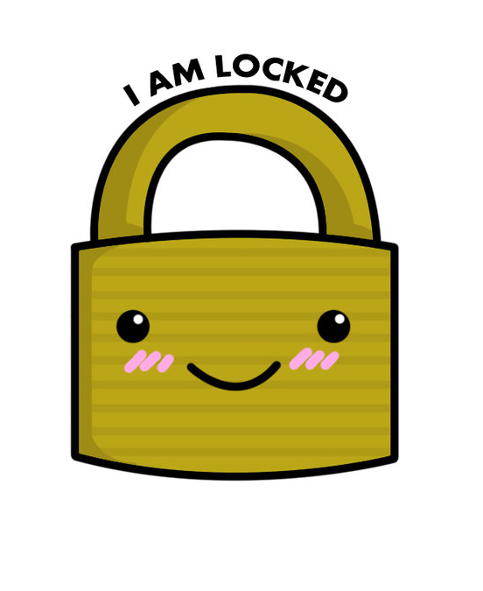
Changing Locks:
If a survivor has a valid Protection Order against someone who is also on the lease, they can request that the landlord change the locks on the unit, at their expense
Or, you could just ask!

Slide 48
A landlord CANNOT legally end leases, refuse renewal, evict or refuse to rent just because someone is a victim of domestic violence, sexual assault, unlawful harassment and/or stalking.
A landlord CAN end tenancy or evict for other, lawful purposes, such as failure to pay rent.

Slide 49
It’s a LOT to remember…
Luckily, you don’t have to!
Resources:
Tenantsunion.org
www.solidground.org/tenant
WA Residential Landlord-Tenant Act
Leg.wa.gov

Slide 50
Housing protections:
For survivors living in public housing

Slide 51
Protections for survivors in public housing
Violence Against Women Act (VAWA)
VAWA 2005 provided a LOT of protections for survivors
VAWA 2013 expanded those protections to additional rental housing programs
Survivors of domestic violence, dating violence, sexual assault and stalking all are covered
Remember: We have the Residential Landlord-Tenant Act that provides protections for survivors in non-public housing
Notes:
Survivors of domestic violence, sexual assault and stalking who do not live in subsidized housing and therefore are not covered by VAWA may still be protected by federal and state fair housing laws. Additionally, many states and municipalities have enacted specific protections for survivors of domestic violence, sexual assault and stalking.

Slide 52
Housing Programs Covered by VAWA
Public Housing
Section 8 Housing Choice
Section 8 project-based
Low Income Tax Credit Housing
McKinney-Vento Programs
Transitional Housing
Rapid Re-Housing

Slide 53
Who Must Comply with VAWA?
Public Housing Authorities (PHAs)
Owners and managers participating in covered housing programs (that could be you!)
VAWA Occupancy Rights are provided to applicants and tenants
Notes:
Clarify for RRH and other diversion and prevention funds that are funded
The VAWA Notice of Occupancy Rights must be provided to: all adult applicants, not just those identifying as survivors
The VAWA Notice of Occupancy Rights must be provided as follows:
For applicants:
At the time the individual is provided assistance or admission
At the time the applicant is denied assistance or admission
For tenants/participants:
With any PHA notification of eviction or termination of assistance
By December 16, 2017, either during the PHA annual recertification or lease renewal process (as applicable). If there will be no recertification or lease renewal during the first year, through other means within the first year as determined by the PHA (19)

Slide 54
Accessing Housing
Survivors cannot be denied shelter, housing, housing assistance, terminated from participating in or evicted from housing on the basis that they are a victim of domestic violence.
Survivors cannot be denied assistance or tenancy solely on the basis of criminal activity or poor credit directly related to domestic violence.
Notes:
Or denied renewal of assistance due to domestic violence
For example, a housing provider cannot deny an applicant housing/assistance because of domestic violence, including a criminal history or poor credit history connected with domestic violence;

Slide 55
Evictions & Terminations
Managers and owners:
CANNOT: evict a survivor or terminate assistance due to an incident of domestic violence
CAN: evict a survivor or terminate assistance if it can be demonstrated that there is an “actual or imminent threat” to other tenants
Notes:
Not a violation of the lease
There is no definition of actual or imminent threat

Slide 56
What if a Survivor Shares a Lease?
Leases can be “bifurcated”
Eviction or termination of assistance to one party without penalizing a survivor.
If the lease split, survivors can stay in unit and request to establish eligibility for assistance.
PHAs and owners MUST give survivors the opportunity to establish eligibility, and offer reasonable time to do so.
Notes:
When an owner allows for bifurcation, they may (but are not required) to evict the abuser without removing the survivor from the unit. If the owner does this, they must immediately notify the PHA and provide an updated lease. With the exception of units owned by the PHA, the PHA cannot bifurcate a lease between owner and tenant if the owner chooses not to.
If the evicted tenant was the abuser, the housing provider must provide non-eligible survivors a period of 30-days from the date of bifurcation to:
Establish eligibility for the same housing program
Establish eligibility for another housing program
Find alternative housing

Slide 57
Things to think about…
A change in family size may impact the determination of the appropriate number of bedrooms and the amount of subsidy paid
Immigration status
Notes:
When choosing to bifurcate a lease, there may be consequences. Most namely, a change in family size may impact the determination of the appropriate number of bedrooms and the amount of subsidy paid by the PHA to an owner. PHAs may grant exceptions if they determine that it is justified by age, sex, health, disability, familial relationships or personal circumstances. There is no specific policy for survivors at this time.
This will likely be an issue for mixed families, where assistance is provided to the abuser and the survivor is a member of a household who does not have eligible immigration status.

Slide 58
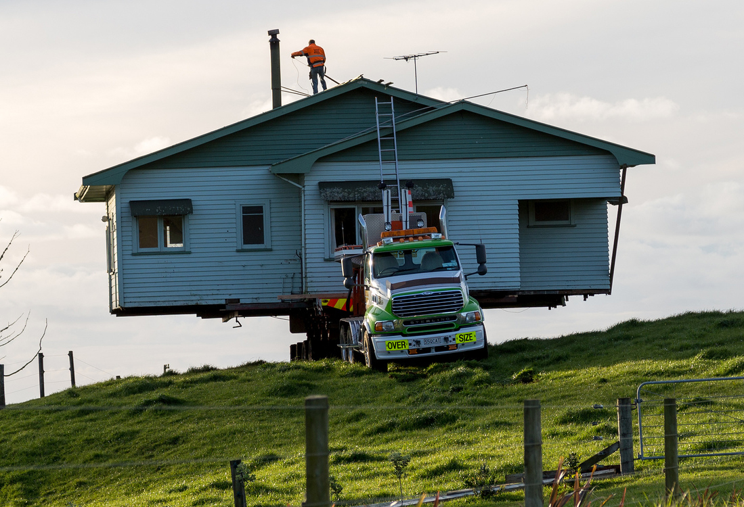
Moving AKA “Portability”
Survivors with Section 8 vouchers can move to another jurisdiction for safety reasons, even if the lease has not expired.
What about survivors in other housing programs?

Slide 59
Emergency Transfers
Survivors can request to transfer to another available, safe unit assisted under the covered housing programs
If they have been living in PHA for one year or more, they must be given priority for the next available opportunity for continued tenant-based rental assistance.
Survivors are not required to give advance written notice (including a copy to the PHA) of intent to vacate if relocating for safety planning purposes.

Slide 60
These Protections are in Place. How do Survivors Access them?
Notify the PHA or owners about what’s happening
PHAs and owners can (but don’t have to) request certification from a survivor.
Self-certification
Agency- approved form
Documentation signed by a third party (THAT’S YOU!)
Notes:
Address conflicting certification

Slide 61
Confidentiality:
HMIS: No personally identifying information should be added to HMIS.
Confidentiality of information about domestic violence, dating violence, sexual assault, or stalking. This information can only be shared if requested by the survivor in writing, is required for use in an eviction proceeding or is otherwise required by law.

Slide 62
Information Overload?
That’s okay! We are here, and so are these resources:
NNEDV.org
NLIHC.org
VAWA Resources
WA State Legal Resources

Slide 63
Law Enforcement
A good relationship with local law enforcement is necessary for any housing/homeless provider
Keep in mind that a survivor may not necessarily want law enforcement involvement for many reasons:
Immigrant and has fears about police from country of origin
Doesn’t want partner arrested (income source or potential to be deported)
Undocumented immigrant
May have warrants
Police intervention not viewed as helpful or welcome

Slide 64
Protection orders
Survivors may not choose to petition for an order due to safety concerns—important that the program not require a protection order
Protection Orders—order issued by the court as a result of a petition by victim for protection from abuser
Orders must be observed in any jurisdiction (Full Faith & Credit)
64

Slide 65
What about immigrants?

Slide 66
Barriers to Accessing Services for Immigrants
Family/Culture
Shame
Isolation
Language
Religion
Immigration
Bureaucracy

Slide 67
Tactics
Creating Fear
Deportation
Children
False information
Economic Abuse
Immigrations status
Isolation/lack of familial support
Lack of knowledge about U.S. laws/protection against DV
Transnational abandonment
Turns community against them
Withholding visa/passport
Notes:
Transnational Abandonment: Abuser brings spouse to U.S. under H4 visa, then they bring them back home and they leave them there (make empty promises)

Slide 68
Resources for Immigrant Survivors
U-Visa
Protection for victims of certain crimes, including DV and SA
No relationship with perpetrator necessary
Application MUST include law enforcement/prosecutor/judge/CPS certification of “helpfulness”
10,000 visa annual cap
After 3 years with visa, they can apply to adjust their status
Must have:
Suffered substantial physical or mental abuse
Been helpful in or willing to cooperate with investigation or prosecution of crime
Occurred in the U.S. or violated U.S. laws
©Asian Pacific Institute on Gender-Based Violence

Slide 69
Resources for Immigrant Survivors, Cont.
Violence Against Women’s Act (VAWA)
Protection from spouses and children of abusive U.S. citizens (USC) and Lawful Permanent Residents (LPR or Green Card Holders)
Must be married or divorced within the past two years
Abuser must be USC or LPR
Does NOT require police to have been called
If approved, can obtain green card status
“Any credible evidence” must be accepted
©Asian Pacific Institute on Gender-Based Violence

Slide 70
Working with dv advocates and agencies

Slide 71
What is the Role of an ADVOCATE?
Pleads for or in behalf of another, intercessor
Identifies systemic problems and fights for accountability of and access to systems

Slide 72
WHAT DOES AN ADVOCATE DO?
Provides survivor-driven, mobile, trauma-informed advocacy
Accompanies, transports, supports in the community and builds bridges to community
Navigates complicated systems for and with a survivor
Walks with and speaks on behalf of survivor at their request

Slide 73
What kind of advocacy?!
Survivor- driven:
Offers options, not opinions or mandates
Considers the unique needs and strengths of each survivor
Asks “what do you need” instead of “these are our services”
Mobile:
Meets survivors literally where they are in the community or at home —and helps them navigate other support systems
Trauma informed:
Considers a survivor’s past and present experience of abuse and its impact
Considers a survivor’s culture and community to increase support, safety and rebuild connections

Slide 74
Voluntary Services
Based on a philosophy that emphasizes providing information and encouraging choice
Shelter/housing eligibility is NOT contingent upon accessing support services
Survivor-driven and relationship-based

Slide 75
A DV & SA Advocate’s Professional Obligations
Use an empowerment model of advocacy
Maintain confidentiality & legal privilege
Help survivors with safety planning & problem-solving
Be accessible & culturally relevant
Keep accurate, minimal records
Report child abuse as mandated
Abide by ethics, policies, contracts
Notes:
WA state statutes support survivor-centered advocacy
Laws support survivor centered advocacy (Laws that help support advocates do their work – there is actual language in state law that supports advocacy work – advocates & survivors have had a voice- that has been heard – that helped craft laws is unique to Washington). Not the same across the country!
Elements to advocacy
Foundations to advocacy
Safety planning is a process not a product
Bread and butter activity of advocates – constant, fluid, changes with expectations/survivors direction

Slide 76
More on Advocate Confidentiality
Recipients of OVW and FVPSA grantees are prohibited from disclosing “personally identifying information” in a shared data base (VAWA and HUD law)
DV programs cannot disclose info without written permission RCW 70.123.076
DV program records are confidential RCW 70.123.075
DV advocates’ communication with survivors is privileged and protected RCW 5.60.060
Privileged Communications (2006), this law protects advocacy info from being subpoenaed in court
Applies to staff & volunteers at community based agencies

Slide 77
Is exposure to Domestic Violence reportable to Child Protective Services?
In Washington State, it is important to know that exposure to domestic violence in and of itself does not constitute child abuse or neglect
What does this mean? A positive disclosure of DV between adults is not something to report to CPS.
RCW 26.44.020 (16)
Resource: https://wscadv.org/wp-content/uploads/2015/06/Making-a-Mandatory-Child-Abuse-Report-Best-Practices1.pdf
https://wscadv.org/wp-content/uploads/2015/06/Mandatory-Reporting-and-Teen-Dating-Violence.pdf
Notes:
Brief overview of reporting requirements by Statute
Local practices vary
Making a report that supports non-abusive parent’s safety and autonomy
See handout “Making a mandatory report – best practices” – for statute citation
CPS comes knocking – Know your rights
WA Children’s Admn, DSHS has developed a Social Workers Practice Guide to domestic Violence, Children’s Administration, Revised May 2010, http://www.dshs.wa.gov/pdf/Publications/22-1314.pdf
Appropriate for advocates to be part of a Family Team Decision – DSHS has a dv protocol, advocates can help keep CPS focused on the intent of their own protocol.
Includes polices and practice recommendations for social workers (including CPS)
When DV is present, witnessing dv is not child abuse – this is child welfare policy.
Mandatory reporting is NOT the ONLY action to take:
Support around parenting
Consult with other advocates and other parenting experts
Identify resources
Get help from colleagues and experts around making the distinction between poor parenting vs. abuse/and or neglect.
Give examples of the kind of harm that would be reportable:
if there is a gun or weapon pointed at you and your child (ren),
if the person is throwing things at you or your children,
hurting you when the child is in your arms.
What about peer-on-peer dating violence? Washington law4 is fundamentally unclear regarding mandatory reporting obligations in the case of peer-on-peer dating violence. If you have “reasonable cause” to believe that a child has experienced abuse or neglect, you must make a report to Child Protective Services (CPS) and/or law enforcement within 48 hours.5 WSCADV consulted with DSHS/Children’s Administration staff, law enforcement, and others and concluded that in most cases teen dating violence6 , 7 will not trigger an advocate’s mandatory reporting duties. That said, if you reasonably believe your client experienced serious physical abuse resulting in actual injury, and particularly if that serious physical abuse is ongoing, you should report it. Your job is to be the most effective advocate possible, even when you are also a mandatory reporter. Many of your advocacy skills can be used to ensure your client understands the process, receives essential support, and is empowered to make informed choices. See this document for more information.

Slide 78
How to make a Supported referral?
Support the survivor in making informed decisions by exploring all of the options available
Encourage rather than require participation with a DV/SA agency
Offer to facilitate making a connection
Check in with survivor consistently about their experience
Advocate for the survivor when needed
Be proactive and reach out to our agencies. Actively seek information and ask questions.

Slide 79
How to work together?
Educate yourself about DV/SA
Required for CoCs in providing safe access for DV/SA survivors to housing/homeless resourcess
Free trainings and webinars available in many counties and online
Know your community resources & the various systems that impact DV survivors
Understand confidentiality and information sharing constraints
Release of Information (ROI)
Make sure your ROI is current. Know that a survivor can revoke a signed ROI at any time.
Keep in mind that the DV/SA Advocate might not have an ROI signed. In which case they can only speak in general terms.
Build relationships before you need them…reach out today!

