Slide 1
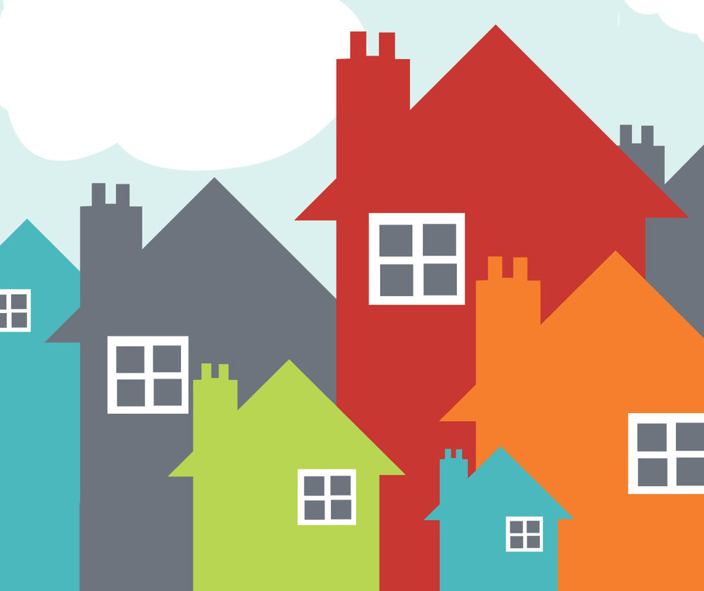
DV and Homelessness

Slide 2
Domestic Violence for Housing/Homeless Providers
The Relationship IS the Intervention!

Slide 3
OUTLINE
DV and Homelessness
Recognizing and Responding to Domestic Violence
Safety Planning: Safety versus SafeR
Legal Protections for DV Survivors
What About Immigrants
Working with DV Advocates and Agencies

Slide 4
WHY IS THIS IMPORTANT?! (Y)OUR PEOPLE ARE (Y)OUR PEOPLE

Slide 5
38%
of all domestic violence victims become homeless at some point in their lives.
Source: Baker, C., Cook, S., & Norris, F. (2003)
Among mothers with children experiencing homelessness, more than
80% had previously experienced domestic violence
Source: Aratani, Y. (2009)
In a California study, women who experienced interpersonal violence in the last year had almost
4 times the odds of reporting housing instability than women who did not experience interpersonal violence.
Source: Pavao, J., Alvarez, J., Baumrind, N., Induni, M., & Kimerling, R. (2007)

Slide 6
How does DV lead to homelessness?
DV is a leading cause of homelessness for women and children (families) in the U.S.
Survivors often must leave housing to escape DV
Survivors may be unable to afford to stay if abuser leaves
May be evicted due to abuser’s behavior
DV interferes with ability to access housing - bad credit, poor rental histories, safety needs
Abusers may sabotage survivor’s economic stability - trouble paying deposit, rent and utilities

Slide 7
IMPACTS OF TRAUMA ON HOUSING STABILITY
DV/SA can severely disrupt survivors’ lives & are significant contributing factors to chronic homelessness in women
Survivors who can’t retain their housing are highly vulnerable to re-abuse
Homeless survivors may seek the perceived safety of a new partner and become the victim of survival sex and other coercive control
Survivors may engage in illegal activity in order to survive, leading to criminal history records
Survivors frequently become disconnected from their social support network

Slide 8
People of color more likely to experience homelessness
Center for Social Innovation’s SPARC (Supporting Partnerships for Anti-Rascist Communities) project examined over 111,000 HMIS records, collected 148 oral histories of people of color experiencing homelessness, conducted 18 focus groups in six U.S. communities, and found:
More than 78% of people experiencing homelessness were people of color. The general population in the U.S. is 74% White, 12.4% Black, and 17.2% Hispanic/Latinx.
Black people comprise 13% of the general population in the U.S. and 26% of those living in poverty, yet account for more than 40% of the homeless population. Poverty rates alone don’t explain the over-representation.
Homelessness among American Indian/Alaska Native people was three to eight times higher than their representation in the general population.

Slide 9
ROOT CAUSES OF HOMELESSNESS ARE STRUCTURAL
Lack of affordable housing, economic immobility, and systemic racism
People did not become homeless because of lack of financial resources, but rather as a result of fragile social networks marked by two weak points: lack of financial capital and lack of emotional support.
SPARC calls this phenomenon “network impoverishment” —a phenomenon in which it is not just the individual or family who is experiencing poverty; the network itself functions in an impoverished state
DV/IPV was also identified as a common thread in the lives of many respondents across gender and age ranges.

Slide 10
DON’T FORGET THE CHILDREN
More than half of DV survivors live in households with children under 12
47% of homeless school-aged children and 29% of homeless children under 5 have witnessed domestic violence in their families
Exposure to violence significantly impacts development, behavior, education, health, mental health, and increased risk- taking behaviors as adolescents and adults
Notes:
Remembering that many of the DV survivors you encounter will have children, it’s clear that being prepared to attend to children’s needs is also imperative.

Slide 11
LGBT Homelessness
Discrimination not only threatens access to housing but the stability of communities
Members of the LGBT community are more likely to become homeless
Once homeless, they are more likely to endure discrimination and harassment that extends their homelessness
Between 20 and 40 percent of all homeless youth identify as LGBT
Housing instability may force them into survival behaviors that jeopardize their wellbeing and safety.
Notes:
HUD Exchange

